Slide 1
Syntax: An Introduction
Splash at Stanford University
December 1, 2018
Ji Hun Wang

Slide 2
INTRODUCTION
Plan
0. Brief Introduction
1. What is Syntax?
Terminology of Syntax
Syntactic Rules and Phrases
Syntactic Diagrams
Dependency Grammar and Constituency Grammar
Applications of Syntax
Final Discussion

Slide 3
Brief Introduction

Slide 4
BRIEF INTRODUCTION
Who am I?
Name: Ji Hun Wang
Place of Birth: Seoul, Republic of Korea
Date of Birth: December 27, 1999
> ☺: Can relax near the end of the year
> ☹: Christmas – My birthday – New Year (???)
Current State: Freshman at Stanford University
Expected Major(s): Linguistics, Computer Science
Interest: Math, Classics, music composition, late-night talks …
[ At age 8 ]

Slide 5
BRIEF INTRODUCTION
Who are you?
Now, here’s a brief question:
Name: Ji Hun Wang
Place of Birth: Seoul, Republic of Korea
Date of Birth: December 27, 1999
> ☺: Can be relaxed near the end of the year
> ☹: Christmas – My birthday – New Year
Current State: Freshman at Stanford University
Expected Major(s): Linguistics, Computer Science
Interest: Math, Classics, music composition, late-night talks …
[ At age 8 ]

Slide 6
BRIEF INTRODUCTION
About This Course
σύνταξις
Ancient Greek
”coordination”
“together” + “order/rule”

Slide 7
BRIEF INTRODUCTION
About This Course
SYNTAX
A branch of linguistics that studies
rules, principles and processes
that govern the structure of sentences
Focus on generative grammar = constituency grammar

Slide 8
BRIEF INTRODUCTION
A Few Rules
Feel free to participate
Be kind and nice to each other
Ask if you have any questions, even in the middle of the lecture
You are the BEST

Slide 9
Part 1
What is Syntax?

Slide 10
WHAT IS SYNTAX?
History of Syntax
Ancient India – Panini Grammar
Prior to
formal linguistics
Rome & Greece – Philosophy and Rhetoric
Advent of
formal linguistics
General Grammar
19th Century
Historical-comparative Grammar
Modern days
Theoretical Grammar

Slide 11
WHAT IS SYNTAX?
Questions in Syntax
Syntax and
language acquisition
Experimental
syntax
Syntax of
natural languages
Syntax and
speech processing
(voice recognition)

Slide 12
WHAT IS SYNTAX?
Research Questions in Syntax
Syntax and
language acquisition
Experimental
syntax
Understanding human languages better
Central medium of communication
Syntax of
natural languages
Syntax and
speech processing
(voice recognition)

Slide 13
Part 2
Terminology of Syntax

Slide 14
TERMINOLOGY OF SYNTAX
Grammatical Terms
How is a sentence constructed?
(Hint: Start with letters!)

Slide 15
TERMINOLOGY OF SYNTAX
Part of Speech & Noun
Part of speech (= syntactic category or word class)
Noun
[N]
How can you define this part of speech?
(Avoid including the name of the part of speech in its definition!)
How can you determine this part of speech?
(Think in the sentence level!)

Slide 16
TERMINOLOGY OF SYNTAX
How can you define these parts of speech?
(Avoid including the names of the parts of speech in their definitions!)
Verb, Adjective & Adverb
How can you determine these part of speech?
(Think in the sentence level!)
Verb
[V]
Adjective
[Adj]
Adverb
[Adv]

Slide 17
TERMINOLOGY OF SYNTAX
Determiner, Preposition & Conjunction
Determiner
[D]
Preposition
[P]
Conjunction
[Conj]
Functional (or closed)

Slide 18
TERMINOLOGY OF SYNTAX
Parts of Speech Revisited
Parts of speech are relative.
Some languages may have parts of speech that are not existent in other languages
All words belong to at least one part of speech.
There are several words that belong to multiple parts of speech
Grammatically correct sentences generally have a structure.
Sentences can be created in many ways,
but grammatically absolutely correct sentences conform to certain rules.

Slide 19
TERMINOLOGY OF SYNTAX
Verb Close-Up
Intransitive
Transitive
Ditransitive
Need 0 object
(1 argument)
Need 1 object
(2 arguments)
Need 2 object
(3 arguments)
smile
arrive
I smile.
* I smile class.
* I arrive house Jim.
hit
love
I love you.
? I hit.
* I love Mary apple.
give
put
I give him the salt.
? I put.
? I give water bottle.

Slide 20
Part 3
Syntactic Rules and Phrases

Slide 21
SYNTACTIC RULES AND PHRASES
Phrases
The students loved their syntax lectures.
?
Words with relationship represented as linear string of words
Simple linear string of words
How would you analyze the sentence above?
Hint: Found “chunks” (linguistic term: constituents)!
Notes:
Write on the board
“The student” in the same chunk (bigger unit = constituent)
What is a phrase?

Slide 22
SYNTACTIC RULES AND PHRASES
Phrases
The students loved their syntax lectures.
Are you ready to learn about the RULES?
?
Words with relationship represented as linear string of words
Simple linear string of words
How can you analyze the sentence above?
(Hint: Found “chunks”!)

Slide 23
SYNTACTIC RULES AND PHRASES
Rule & Noun Phrases (NPs)
An example rule:
XP → X Y Z
Label for the constituent
(a group of ”friend” words)
“consists of”
Elements that form constituents
…and here is a real rule:
NP → N

Slide 24
SYNTACTIC RULES AND PHRASES
Noun Phrases (Cont’d)
NP → N
box
NP → D N
the box
NP → (D) N
Parentheses indicate (optional)
NP → (D) (AdjP) N
the big box
NP → (D) (AdjP) N (PP)
the big box of pens

Slide 25
SYNTACTIC RULES AND PHRASES
Adjective Phrases (AdjP) & Adverb Phrases (AdvP)
AdjP → (AdvP) Adj
very blue
AdvP → (AdvP) Adv
very quickly
SYNTACTIC RULES AND PHRASES
Prepositional Phrases (PP)
Try out by yourself!
Notes:
Show the examples first
And let students come up with the rule

Slide 26
SYNTACTIC RULES AND PHRASES
Verb Phrases (VP)
VP → V
eat
VP → V (AdvP)
eat quickly
VP → (AdvP) V (AdvP)
always left quietly
…
VP → (AdvP) V (NP) (NP) (AdvP) (PP) (AdvP)
Notes:
Show the examples first
And let students come up with the rule

Slide 27
SYNTACTIC RULES AND PHRASES
Phrase v. Clause
Phrase: A group of words with no subject-verb combination.
Clause: A group of words with subject-verb combination.
Independent clause
Dependent clause
SENTENCES
SENTENCE
Notes:
Show the examples first
And let students come up with the rule

Slide 28
SYNTACTIC RULES AND PHRASES
Phrase v. Clause
Phrase: A group of words with no subject-verb combination.
SAT
Clause: A group of words with subject-verb combination.
Independent clause
Dependent clause
SENTENCES
SENTENCE
Notes:
Show the examples first
And let students come up with the rule

Slide 29
SYNTACTIC RULES AND PHRASES
Formation of Sentences
Keep in mind that Independent clause = Sentence = Has subject-verb combination.
How would you express independent clause (TP)?
TP → NP VP

Slide 30
Part 4
Syntactic Diagrams

Slide 31
SYNTACTIC DIAGRAMS
Tree Diagrams
A way to indicate the hierarchical structure of sentence constituents by linking words
But how do we link words?
Notes:
Question: Why is “syntax” A, not N?
Is there a rule such as NP -> D NP -> D N N?

Slide 32
SYNTACTIC DIAGRAMS
Tree Diagrams
A way to indicate the hierarchical structure of sentence constituents by linking words
But how do we link words?
RULES
Notes:
Question: Why is “syntax” A, not N?
Is there a rule such as NP -> D NP -> D N N?

Slide 33
SYNTACTIC DIAGRAMS
Concept of Tree Diagrams
The students loved their syntax lectures.
1. Break down (decompose) the sentence using parts of speech!
The students loved their syntax lectures.
D N V D A N
There are many ways to draw a syntax tree. Here’s one method called bottom-up.
Link the items that modify one another. Start with the simplest one.
D N V D A N
Notes:
Question: Why is “syntax” A, not N?
Is there a rule such as NP -> D NP -> D N N?

Slide 34
SYNTACTIC DIAGRAMS
Illustration and Analysis
TP
NP
VP
D
The
N
students
V
loved
NP
D
their
AdjP
N
lectures
A
syntax

Slide 35
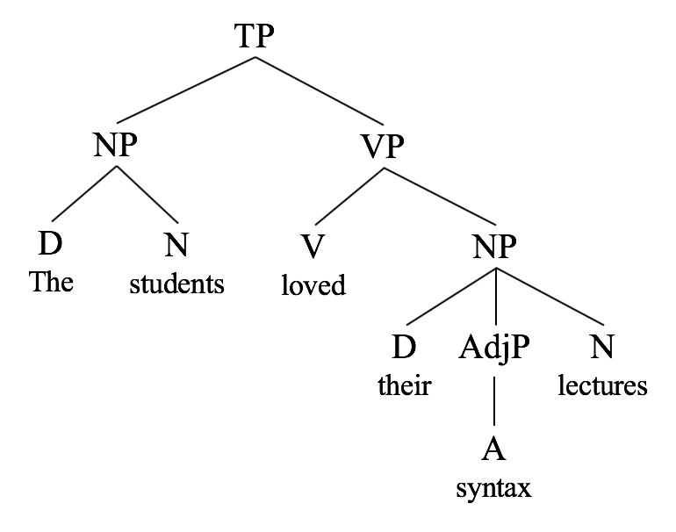
SYNTACTIC DIAGRAMS
Other Kinds of Diagrams
Bracketed diagram: A less intuitive but more linearly organized diagram
[_{TP}[_{NP}[_{D}The][_{N}student]][_{VP}[_{V}loved][_{NP}[_{D}his][_{AdjP}[_{Adj}syntax]][_{N} assignments]]]].

Slide 36
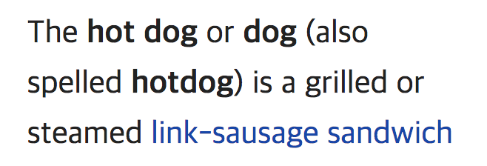
SYNTACTIC DIAGRAMS
Hands-on Tree Diagram
How would you express following sentences with tree diagrams?
I went to school.
Jane gave me a flower.
(+ A sentence of your own)
(Wikipedia)

Slide 37
Part 5
Dependency Grammar
Constituency Grammar

Slide 38
DEPENDENCY GRAMMAR, CONSTITUENCY GRAMMAR
Phrase Structure Grammar

Slide 39
DEPENDENCY GRAMMAR, CONSTITUENCY GRAMMAR
Phrase Structure Grammar

Slide 40
DEPENDENCY GRAMMAR, CONSTITUENCY GRAMMAR
Phrase Structure Grammar
Introduced by Noam Chomsky, also known as constituency grammar
Opposing concept of the dependency grammar
What we have covered so far in the course = generative grammar in constituency grammar
DEPENDENCY GRAMMAR, CONSTITUENCY GRAMMAR
Dependency Grammar
Introduced by Lucien Tesnière
Opposing concept of the phase structure grammar
Structure is determined by relations/connections between words and dependents
Heavily implemented in computational linguistics as a way of parsing sentences
Notes:
That’s what linguists do—you get to interpret sentences in different ways
There’s no “right and wrong” way

Slide 41
DEPENDENCY GRAMMAR, CONSTITUENCY GRAMMAR
Dependency and Constituency
Dependency: one-to-one correspondence
Constituency: one-to-one-or more correspondence
Predicates and
arguments

Slide 43
Part 6
Applications of Syntax

Slide 44
APPLICATIONS OF SYNTAX
Foreign Language Syntax
SVO
What is the general structure (word order) of English sentences?
But is that one and the only word order of all languages?

Slide 45
APPLICATIONS OF SYNTAX
Foreign Language Syntax
SVO
What is the general structure (word order) of English sentences?
But is that the only word order shown in all languages?
Then what are some other word orders?

Slide 46
APPLICATIONS OF SYNTAX
Foreign Language Syntax
S
O
V
V
O
S
Each type of word order
reflects different emphasis
Word order of some languages
are also relatively more flexible than others
45%
(Many Indo-European languages)
3%
S
V
O
O
V
S
42%
1%
V
S
O
O
S
V
9%
~0%

Slide 47
APPLICATIONS OF SYNTAX
Foreign Language Learning Scheme
Start at the syntax level, focusing on how to make sentences!
Syntactically strict language?
Yes: Start with simple sentences, then move
onto compound sentences. See if the
sentences created conform to the rules
No: Try to combine words in different ways to
form sentences as long as the sentences
created are valid
Focus on all of these: reading, writing, listening, speaking + grammar/vocabulary
For languages using non-Latin alphabets, spend some time to be familiar with the new letters (e.g. Arabic, Japanese/Chinese, Korean, Thai, etc.

Slide 48
APPLICATIONS OF SYNTAX
Natural Language Processing
Given a natural language, how can machines understand it?
Do we have to teach machines languages?
We probably can, but it’s impossible to teach all aspects of languages.
Moreover, languages change and evolve!

Slide 49
APPLICATIONS OF SYNTAX
Natural Language Processing
Given a natural language, how can machines understand it?
Resolution: Human languages are generally formed by the rules.
We should teach machines how to interpret the rules!
Do we have to teach machines languages?
We probably can, but it’s impossible to teach all aspects of languages.
Moreover, languages evolve!
With a little bit of linear algebra and implementation of correct methods,
we can teach machines languages effectively.

Slide 50
APPLICATIONS OF SYNTAX
Translation Theory
Neural Machine Translation is an end-to-end learning approach for automated translation, with the potential to overcome many of the weaknesses of conventional phrase-based translation systems.
— Wu, Schuster et al. (2016)
Google’s Neural Machine Translation System
Syntax
Morphology
Semantics
Word processing from input
Information extraction from
pre-learned dataset
Synthesis of information
In the target language

Slide 51
Part 7
Final Discussion

Slide 52
FINAL DISCUSSION
What’s Next?
The field of syntax is extensive
English sentences
(Wh- Questions, etc.)
Different schools
of syntax
Movement
Dependency
Lexical-Functional Grammar

Slide 53
FINAL DISCUSSION
Last Minute Questions?
Survey at:
stanford.esp/classsurvey

Slide 54
Syntax: An Introduction
Thank you for your attendance and participation!

